Slide 1
Introduction to Electrical Circuits Final Term Lecture - 03
Faculty Name: Mr. A N M Shahebul Hasan
Email ID: shahebul@aiub.edu
Reference Book:
Introductory Circuit Analysis
Robert L. Boylestad, 11th Edition

Slide 2


Slide 3
Admittance
The reciprocal of impedance is called admittance.
The unit of admittance is Siemens [S].
G or g is called conductance. The unit of conductance is mho or Siemens.
Conductance (G or g) is the reciprocal of resistance (R).
B or b is called susceptance. The unit of susceptance is Siemens.
Susceptance (B or b) is the reciprocal of reactance (X).
B_{L} or b_{L} is called inductive susceptance.
B_{C} or b_{C} is called capacitive susceptance.

Slide 4


Slide 5

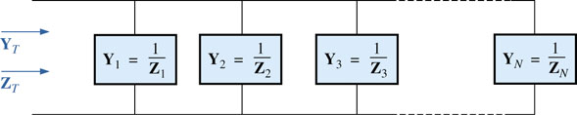
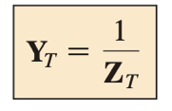
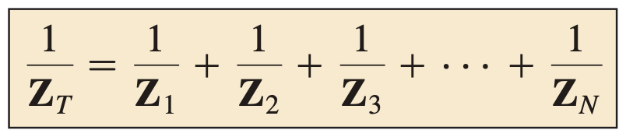
For ac parallel networks, the total admittance is simply the sum of the admittance levels of all the parallel branches.
FIG. 15.58 Parallel ac network.

Slide 6
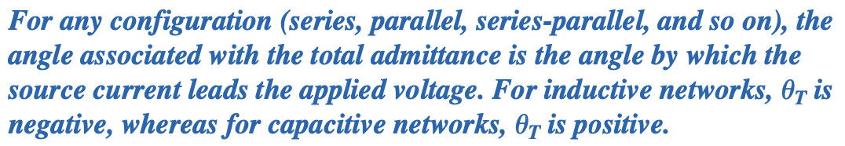
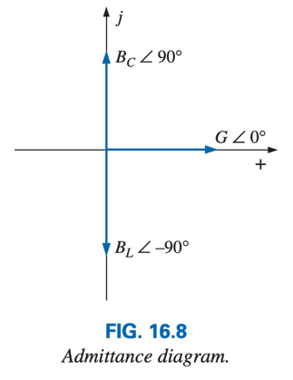

Slide 7
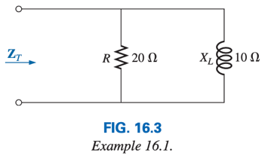
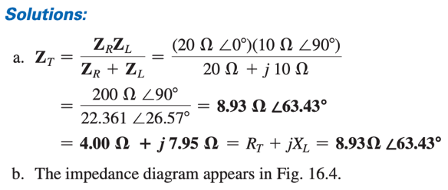
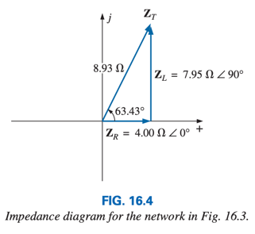
Example: For the parallel R-L network of Fig. 16.3:
Determine the input impedance.
Draw the impedance diagram.
Find the admittance of each parallel element.
Calculate the total admittance of the network.
Sketch the admittance diagram.

Slide 8
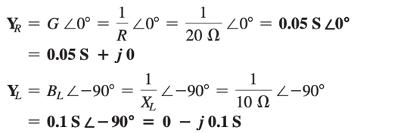


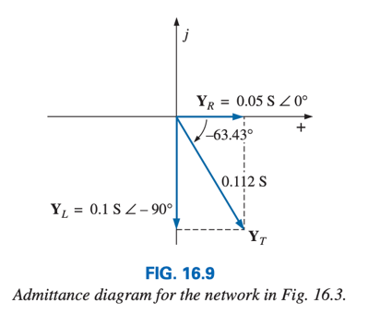
c.
d.
e.

Slide 9
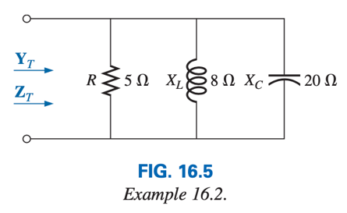
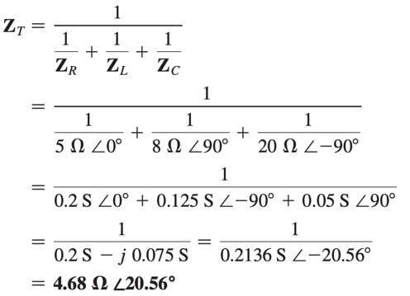
Example: For the network of Fig 16.5:
Determine the total impedance.
Sketch the impedance diagram.
Find the admittance for each parallel branch.
Calculate the total admittance of the network.
Sketch the admittance diagram.
Solutions:

Slide 10
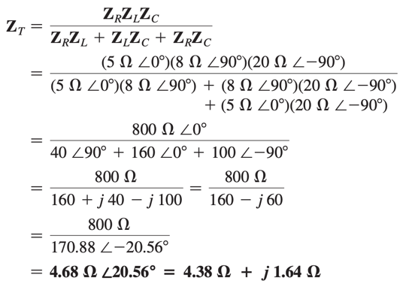
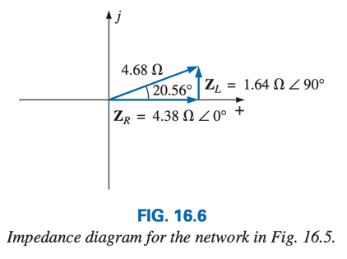

Slide 11
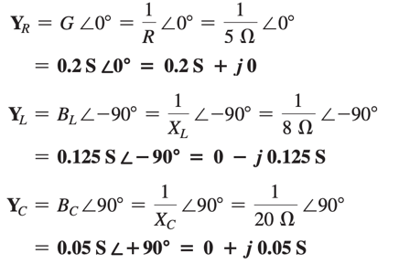
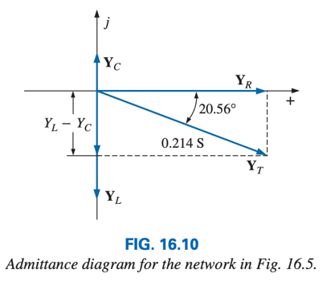
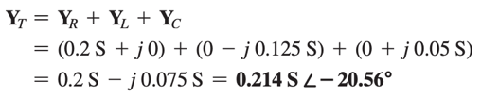

c.
d.
e.

Slide 12
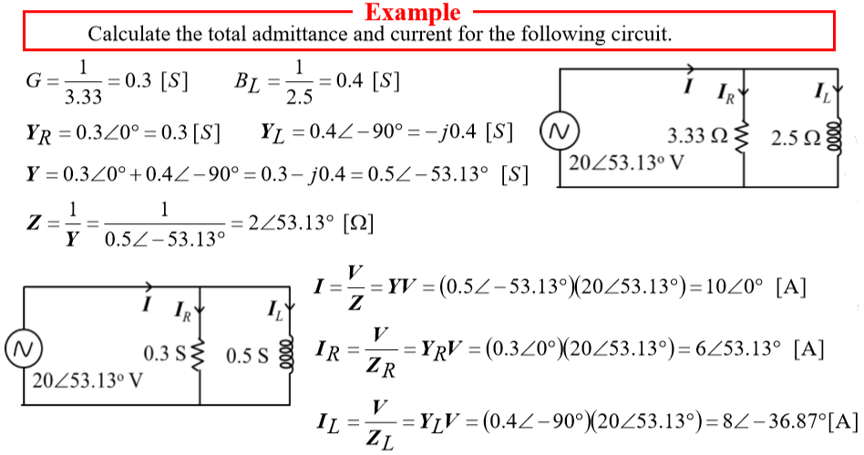

Slide 13
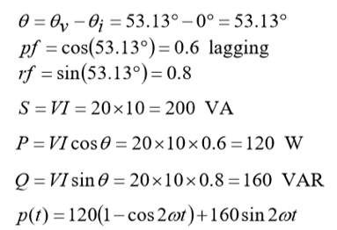
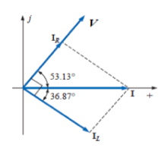

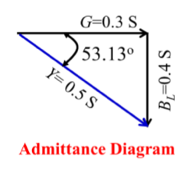
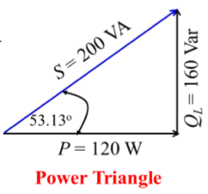

Slide 14
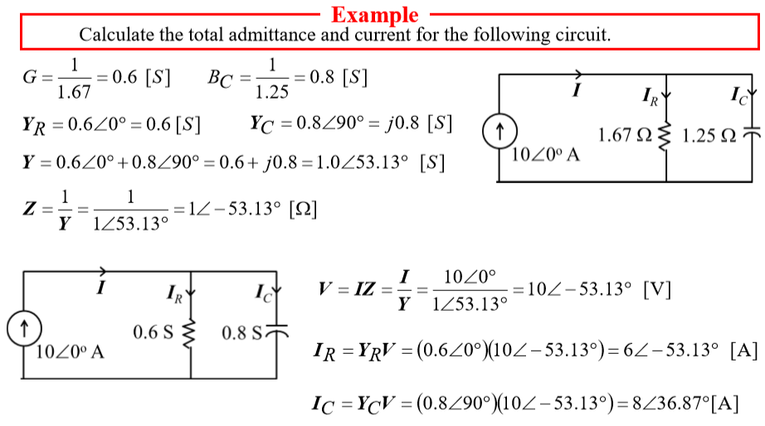

Slide 15
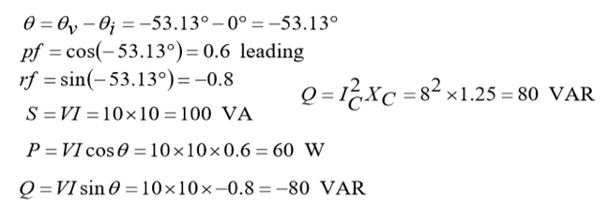
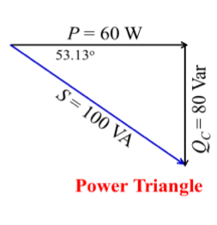
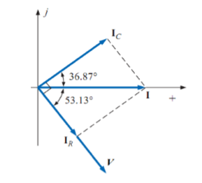
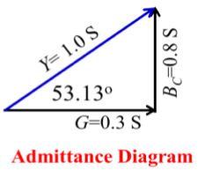

Slide 16
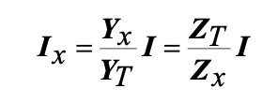
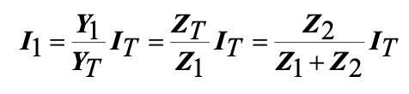
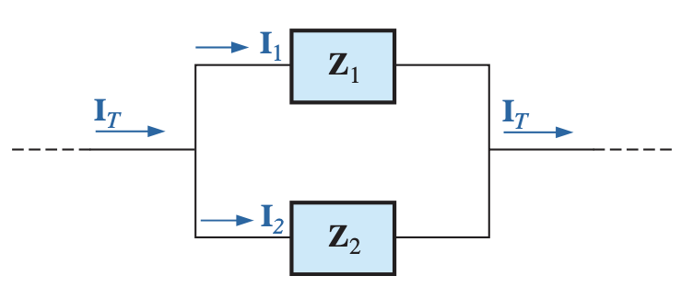
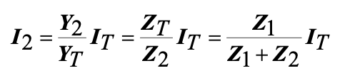
Current Divider Rule
Current Divider Rule only for two branch circuit:

Slide 17
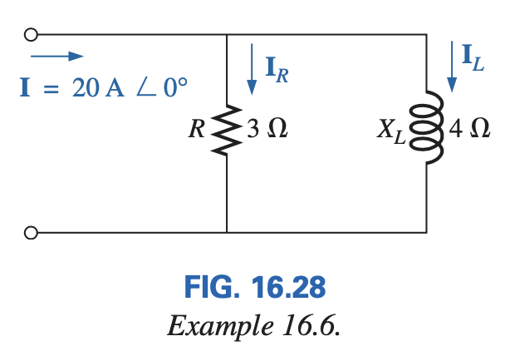
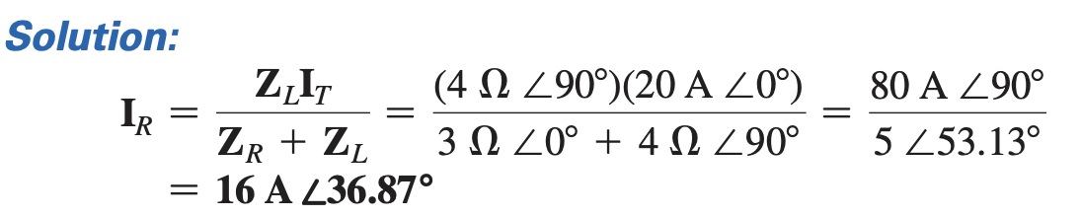
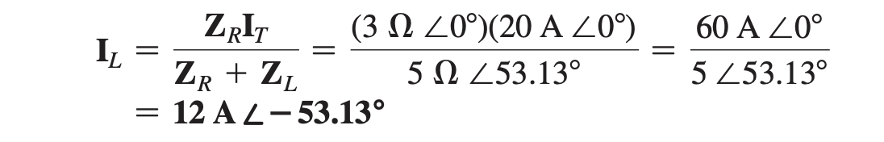
Example: Using the current divider rule, find the current through each impedance in Fig. 16.28.

Slide 18
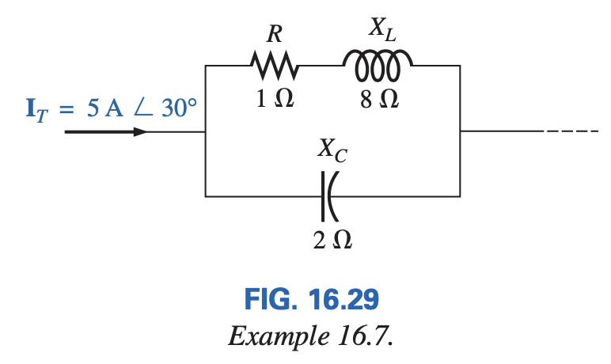
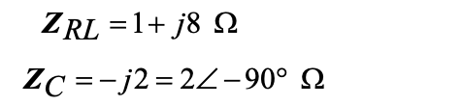
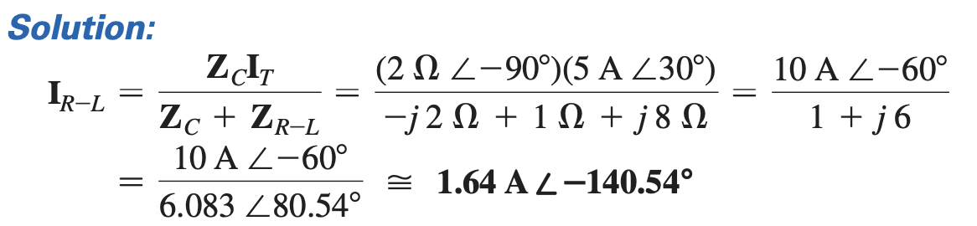
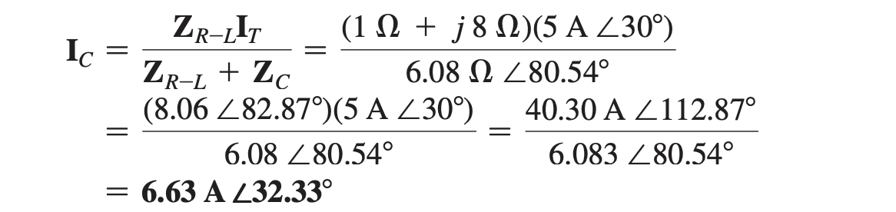
Example: Using the current divider rule, find the current through each parallel branch in Fig. 16.29.

Slide 19
Thank You

